Slide 1
CRM for Admission
Diagrams
Team Id : 54594
Chachapara Jay (160890107004)
Dhaduk Jenish (160890107007)
Hingrajeeya Hemal (160890107010)
Palaliya Raviraj (160890107017)

Slide 2
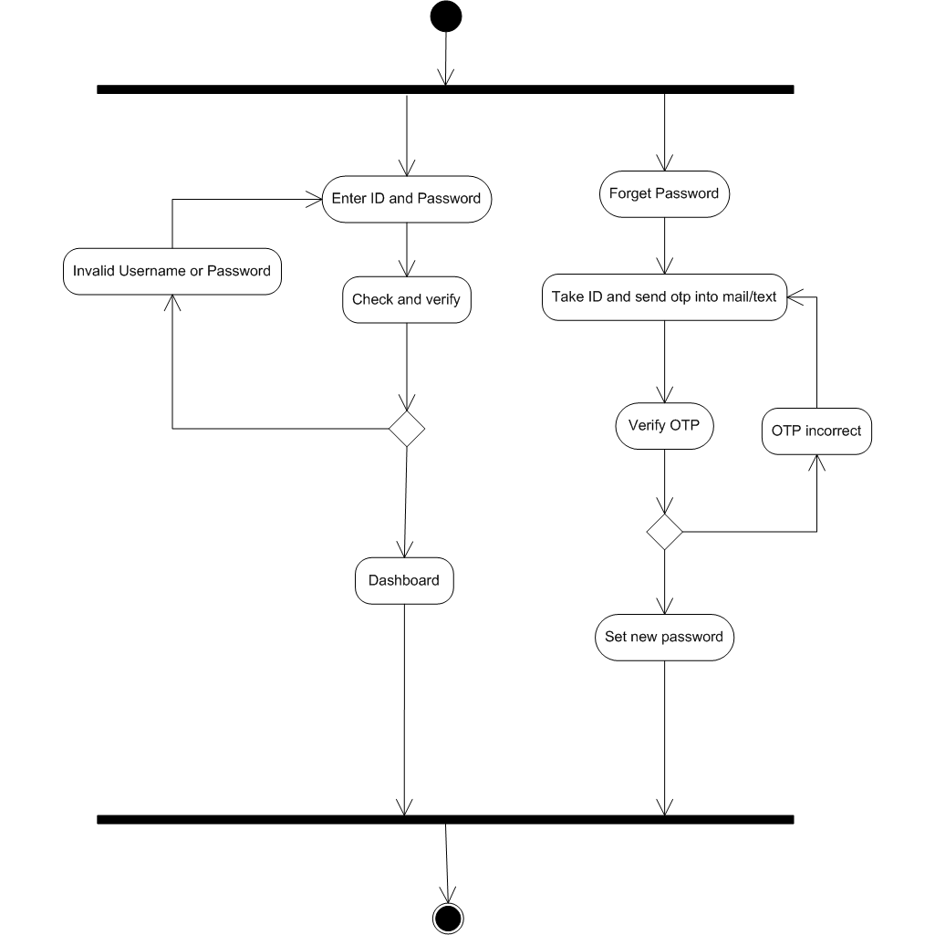
Activity Diagram (Login)

Slide 3
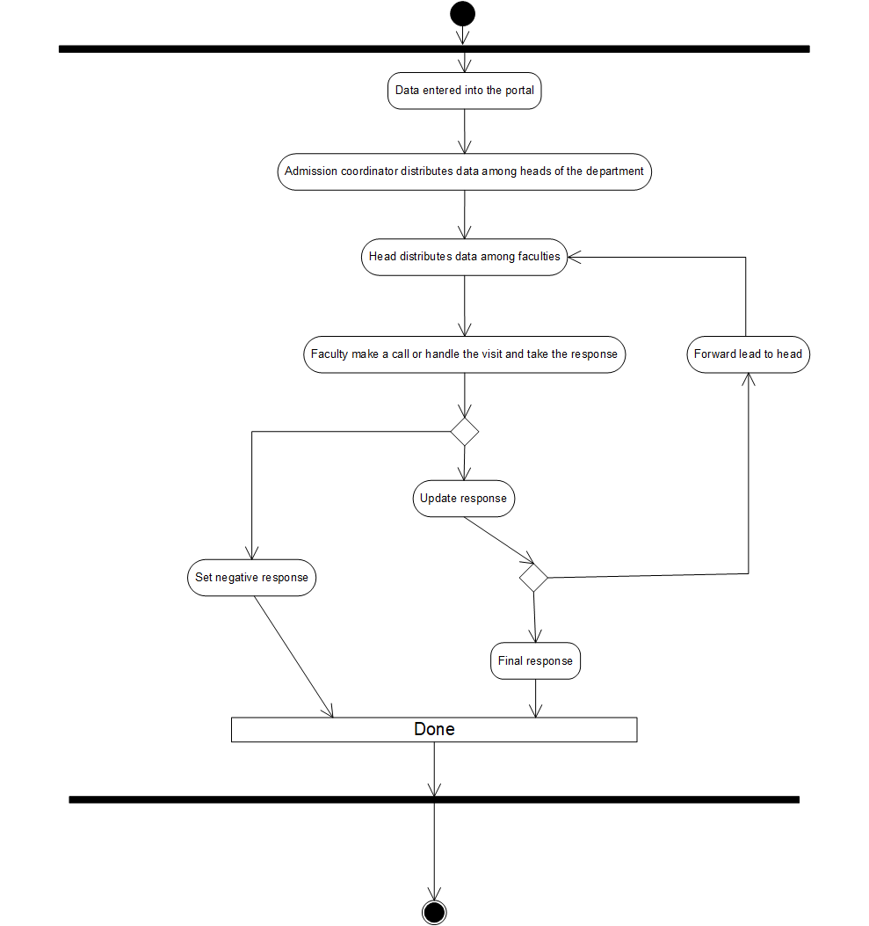
Activity Diagram (Admission)

Slide 4
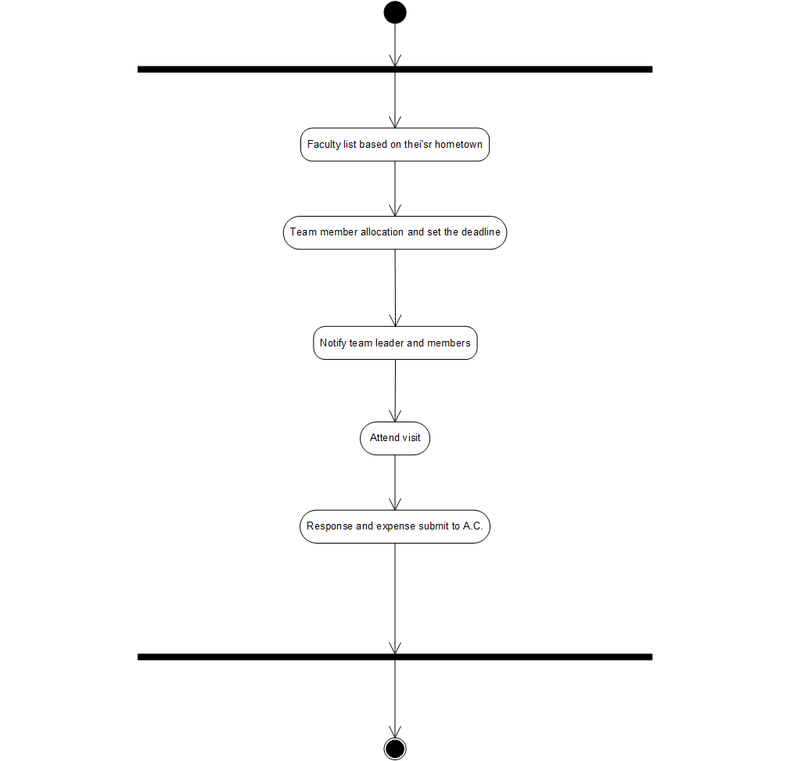
Activity Diagram (Team)

Slide 5
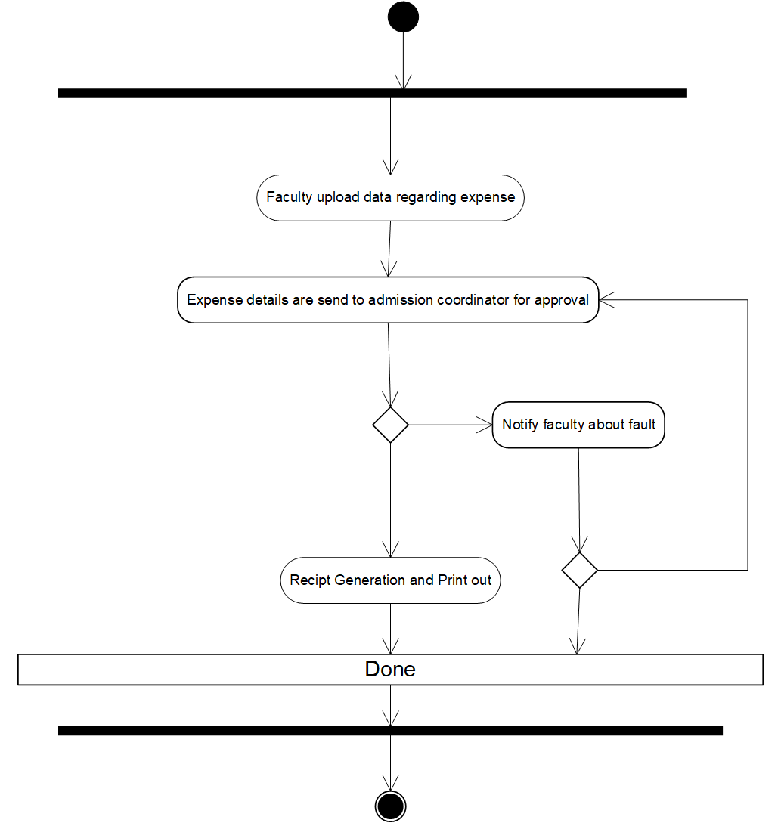
Activity Diagram (Expense)

Slide 6
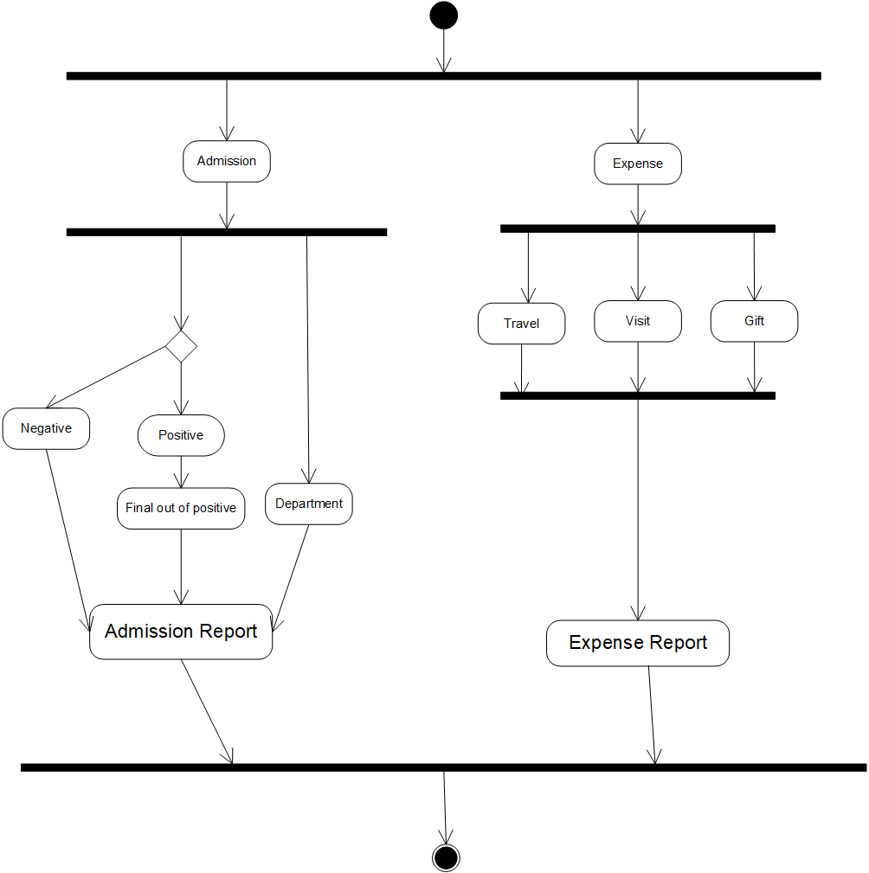
Activity Diagram (Report)

Slide 7
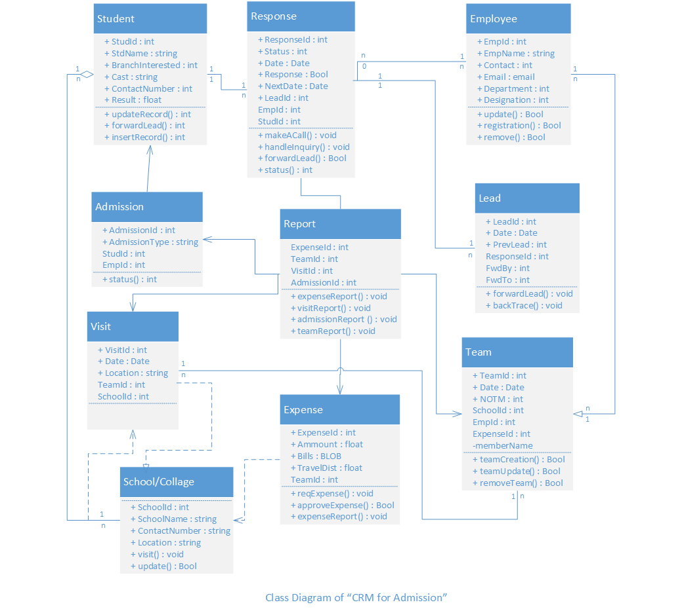
Class Diagram

Slide 8
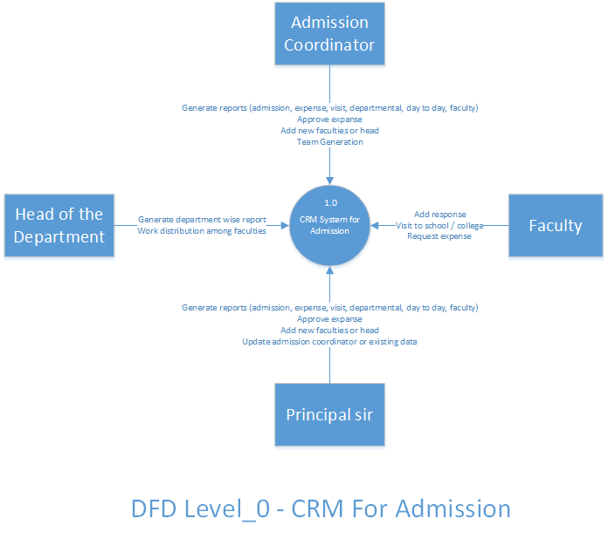
Data Flow Diagram (Level - 0)

Slide 9
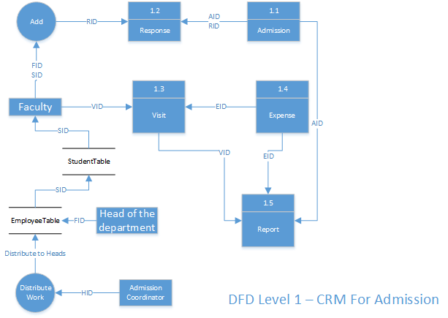
Data Flow Diagram (Level 1)

Slide 10
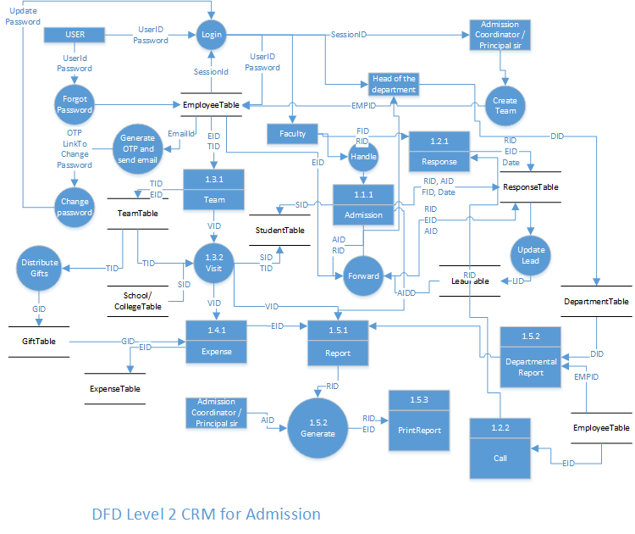

Slide 11
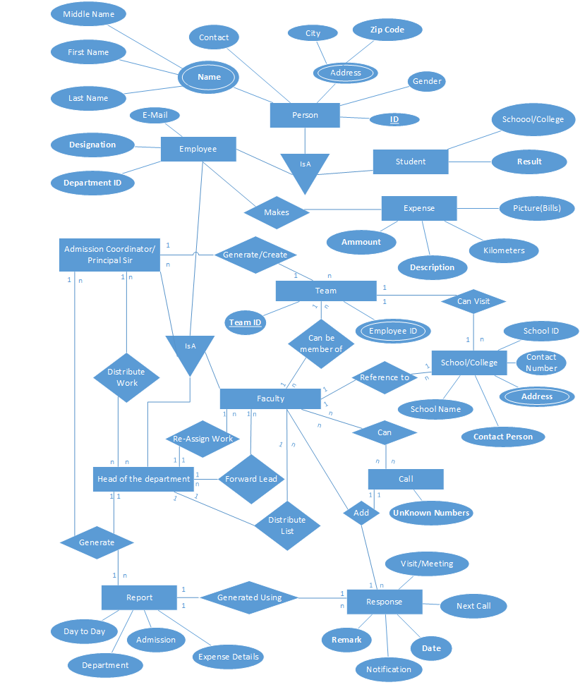
ER Diagram

Slide 12
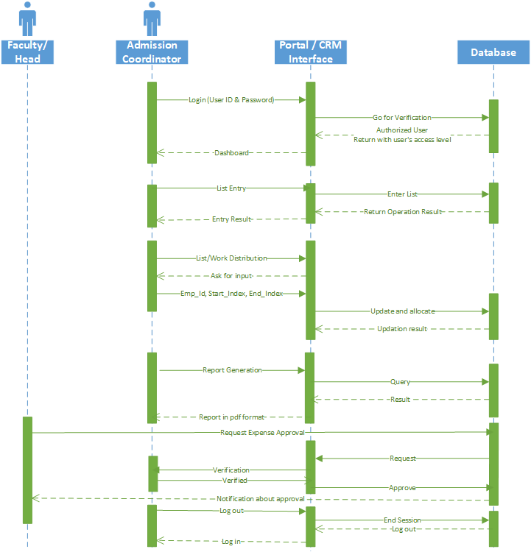
Sequence Diagram

Slide 13
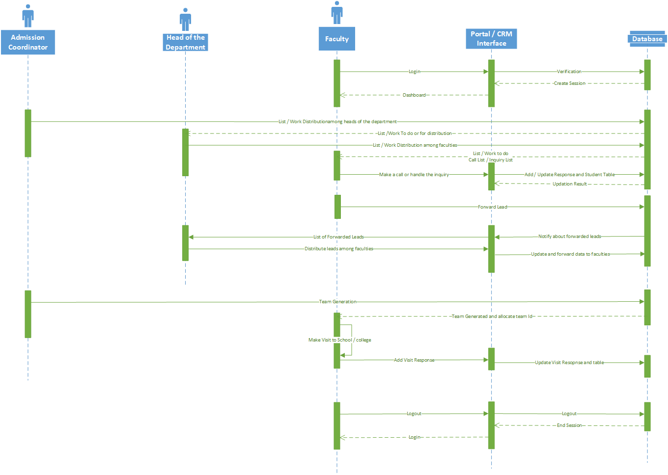
Sequence Diagram

Slide 14
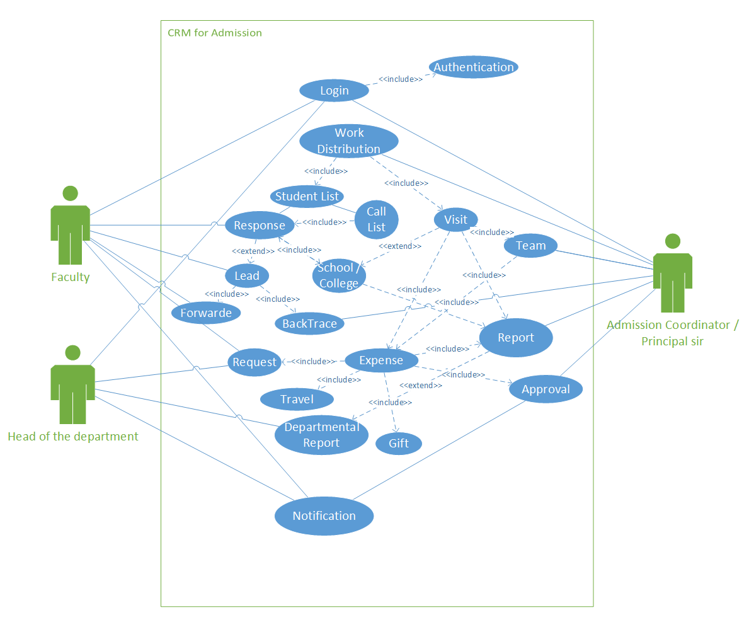
Use Case Diagram

